Slide 1

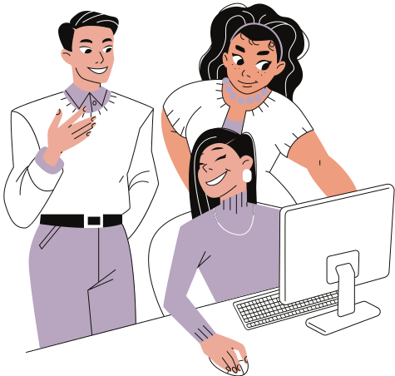

SEXISM
Addressing Life Equality Rights Together
A . L . E . R .T
ST JOSEPH SCHOOL
LASALLE
PRESENTED BY
Group 5

Slide 2

Meet The Group
SHIFRA MEDINA
Group Leader
MARGARETTE ACUYONG
VINCENT DIANCIN
JEREMIAH
ESPINOSA
SABINA TABLAZON
Researcher/ Editor
Researcher
Researcher
Researcher/ Editor

Slide 3
PROJECT PROPOSAL
OBJECTIVES
We want to leave a lesson on why sexism is harmful and why it needs to end
To ensure that the readers are aware of the causes and effects of sexism in society
We intend to provide strategies and solutions on how to stand against gender inequality
BRIEF BACKGROUND OF THE MEMBER’S CONTRIBUTION AND INSIGHTS
This proposal is made by group 5 with the members of Shifra Medina, Margarette Acuyong, Vincent Diancin, Jeremiah Espinosa, and Sabina Tablazon. These are the people who made this project and made it possible to voice out each person's thoughts and opinions on this said topic. The parts in this proposal were divided for each member to finish, Vincent Diancin did the research for the background of the issue, Shifra Medina who researched about the root causes of sexism, Sabina Tablazon stated the stand of the church on this problem, Margarette Acuyong made the rationale for this project, and lastly, Jeremiah Espinosa who came up with solutions on how to deal with or reduce sexism.
SPECIFIC BENEFICIARIES
This condition affects both men and women, however, it is primarily women and young girls that are greatly impacted.

Slide 4

INTRODUCTION
BACKGROUND OF THE ISSUE
Sexism can be a belief that one sex is superior to the other. It is basically prejudice or discrimination based on one's gender. It started way back before, the term sexism emerged from the “second-wave” feminism of the 1960s through the ’80s and was most likely modeled on the civil rights movement’s term racism (prejudice or discrimination based on race). It imposes limits on what men and boys can and should do and what women and girls can and should. Women were once oppressed and are more targeted, the majority thought that women should be housewives instead of joining wars or becoming professionals. Back then women were to do everything in their households for their husbands. Men were also stereotyped to be strong and brave and that leads to them believing that they're weak if they get emotional. Today, some still believe those stereotypes and parents would usually give the tough work to their boys and teach girls house chores.

Slide 5
INTRODUCTION
ITS ROOT CAUSES
Sexism originates from different instances, practices, and issues, and it is most usually used against women and girls in a community. It serves to preserve patriarchy, or male dominance, by the intellectual and material behaviors of individuals, groups, and institutions that are based on their sex or gender. Economic exploitation and social dominance are common kinds of oppression. Sexist behaviors, situations, and attitudes reinforce social (gender) prejudices based on biological sex. Sexism has always been related to stereotypes and gender roles, and it could involve the assumption that one sex or gender is fundamentally superior to the other. The main causes of sexism are Gender stereotypes and Double standards, these forms of discrimination are being practiced by uneducated people that are too ignorant to treat others equally, and sometimes this mindset is passed through the years that it became so normalized in our modern day.
Double standards is the application of various sets of rules to situations that are, in theory, identical. It's a term that's typically used to indicate how one group is afforded more freedom than another. When two or more people, groups, organizations, circumstances, or events are handled differently even though they should be treated the same way, it is called a double standard.
Gender stereotypes is a generic view or preconception regarding the features or characteristics that women and men should or should not have, or the duties that women and men should or should not do. When a gender stereotype hinders women's and men's ability to develop personal abilities, pursue professional jobs, and/or make life decisions, it is damaging. This dictatorship of an attitude where other dictates the lives of others just to fit the “norm” is an unhealthy way of shaping a person that has a different mindset.

Slide 6

Gender discrimination is one of the most serious issues challenging our society today. "We are children of Heavenly Parents," the church claims. Gender plays a significant role in who we are before, during, and after we die. Men and women are on an equal level, neither is superior than the other. Every person must be treated as a child of God, deserving of dignity and respect.
STAND OF THE CHURCH

Slide 7
RATIONALE
The purpose of this project is to promote gender equality and stop sexism. It is important for people to understand sexism and how it affects everyone. We have to stop imposing gender roles and stereotypes, especially on children. We have to stop telling them that girls and boys have their own clothes, colors, toys, abilities, or activities that they should be interested in. Because if this continues, everyone will spend the rest of their lives trying to fit in with society’s standards and gender norms. Sexism greatly affects women and girls, there are still countries out there that deny them education and basic human rights. Women usually get fewer opportunities, less recognition, and less salaries than men and they often get exposed to discrimination and objectification. As for men, they are denied mental and emotional support because they are stereotyped as always strong and enduring but never vulnerable. If they act feminine or if they’re not muscular they’ll be seen as weak or gay. Double standards are also a factor in sexism. If women are intelligent, assertive, and strict she is most likely to be called bossy or competitive but when men show these qualities they are seen to be good or natural leaders. On the other hand, men who get sexually assaulted usually don’t tell authorities because they are afraid to be judged and viewed as weak or lame for not being able to defend themselves and if they end up telling authorities, people doubt them but when women get sexually assault everyone pity’s them immediately. Sexism affects people mentally, physically, and emotionally and that is why we have to stop it because there is no need for it to exist. Sexism still happens to this day but if we want to make a change and end sexism we have to stop accepting it and start speaking up, that is the whole point of this project and why this proposal is important.

Slide 8
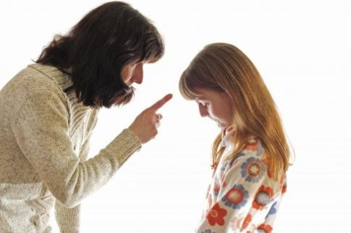
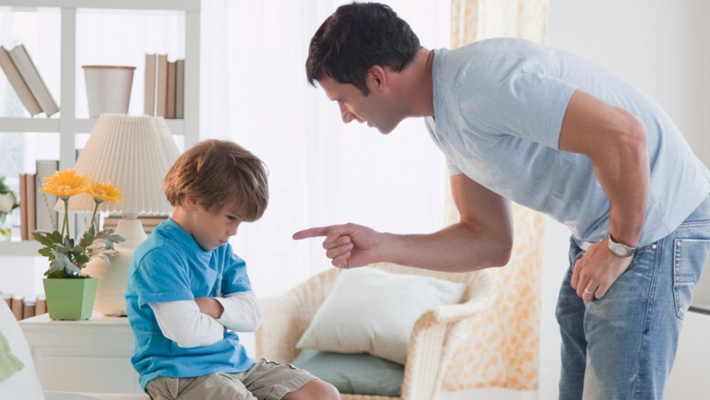
SOLUTIONS
Stop imposing stereotypes and gender roles in the family.
Everything begins at home, and that is why parents should set a good example and treat their children equally. Be aware of gender roles, such as the idea that women should do house chores more because they're a girl. Refrain from telling children what activities or games they should join in or what clothes and toys they should like. Beliefs about the value of boys versus girls are commonly reflected in the way parents treat their kids, therefore parents should be mindful of what they teach and tell their children.

Slide 9


SOLUTIONS
Prevent sexism in schools
For us to stop or avoid sexism in schools, it should start with the teachers and how they treat their students and what they teach to them. Most learners tend to look up to their teachers a lot. Therefore, teachers play a critical role to prevent gender stereotypes and reduce gender bias in the classroom. Teachers should learn about children as individuals and not judge them based on their gender. They should respect and treat their students equally, disrupt gender stereotypes and double standards, ask all students to participate in a variety of classroom chores and other activities, use gender-neutral language, and encourage mixed-gender play.

Slide 10

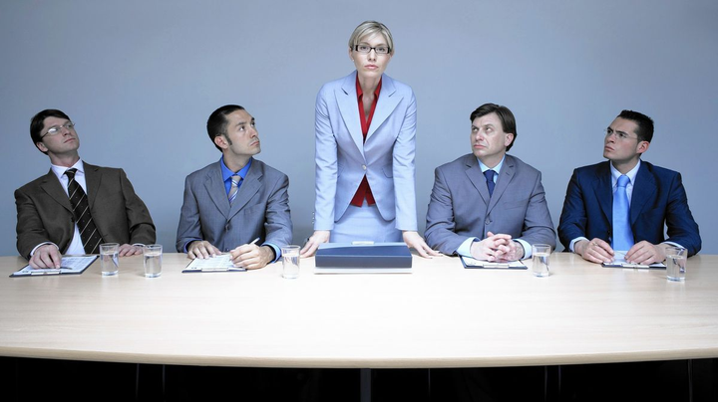
SOLUTIONS
Stop discriminating women in workplaces
In order to reduce sexism in workplaces and promote equality, we have to ensure that everyone recieves the same opportunities, privileges, and treatment without gender being brought up. We should support women into more senior roles, implement gender-neutral recruitment processes, offer equal pay for equal work, provide training on unconscious bias, and have a clear policy on discrimination.

Slide 11
Dear Lord,
We thank you for your presence and love in our lives. Teach us to express your love and compassion in ways that benefit the entire world. Help us to recognize the problems we face in the world and to find the courage to work to solve them. We pray that our fellow brothers and sisters would be filled with love and a sense of fairness for all. Don't lead them astray with principles that could lead to injustice and inequity; instead, teach them how to serve one another without hatred or darkness in their minds; instead, fill their hearts with joy and purity. Amen.
PRAYER

Slide 12
ACKNOWLEDGEMENT
I would like to thank my members for being cooperative and engaged with our chosen topic, each has shown interest in this proposal and has given a great contribution to make this project possible. Also, this would not be feasible if we were not presented by these following sources:
https://www.britannica.com/topic/sexism
https://human-rights-channel.coe.int/stop-sexism-en.html
https://www.churchofjesuschrist.org/study/new-era/2020/01/q-a/what-is-the-churchs-stance-on-feminism?lang=eng
https://en.wikipedia.org/wiki/Sexism#:~:text=Sexism%20is%20judging%20people%20by,expressed%20toward%20women%20and%20girls.
https://learningenglish.voanews.com/a/promoting-gender-equality-with-teaching-strategies/3986846.html

Slide 13
Thank
You
Do you have any questions?

